Slide 1
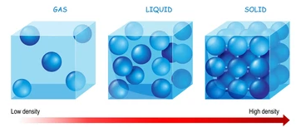
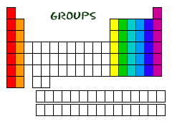
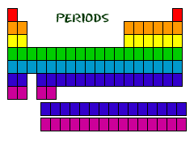
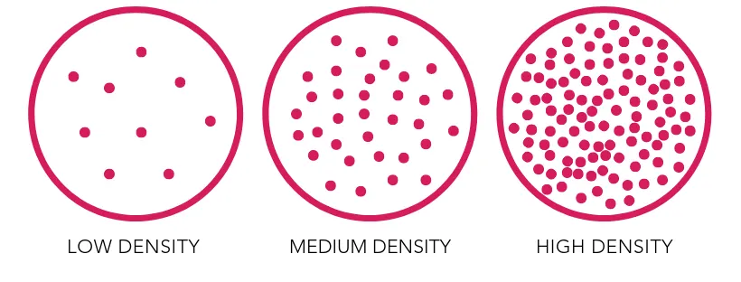
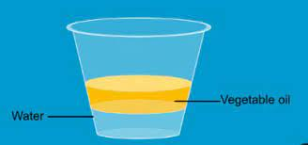
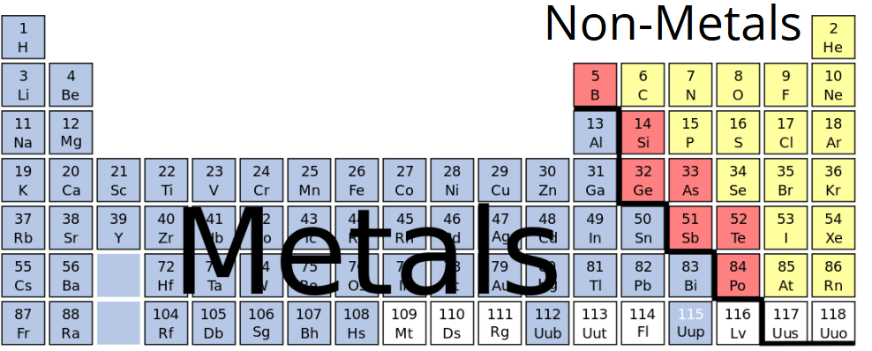


Knowledge Organiser
Year 8: Periodic Table – Using the PT
Groups and properties?
Each group has shared chemical properties
This is because elements in the same group have the same number of outer shell electrons
All that changes is how reactive the elements are e.g. lithium and sodium both fizz with water, but sodium also sparks
What is density?
Density is the mass of an object divide by its volume
A high density substance has particles which are packed more tightly together
It is measured in grams per centimetre cubed (g/chm³)
How is the periodic table organised?
Elements are arranged in groups (columns) and periods (rows)
Elements in the same group have similar chemical properties e.g. group 1 all react strongly with water
Elements increase in atomic mass across a period
Group | Name | Properties | Trend in reactivity
1 | Alkali metals | Soft, grey, low density, reactive metals | More reactive down the group
2 | Alkaline earth metals | Strong, silvery, low density | More reactive down the group
7 | Halogens | Low melting points, reactive, toxic | Less reactive down the group
8 | Noble gases | Low melting points, very unreactive | Unreactive, do not form compounds
Particle diagram comparing the density of the three states of matter
Diagram which shows the layout of groups and periods on the periodic table
Particle diagram comparing a low, medium and high density gas
Position of metals and non-metals?
Metals are found to the left of the periodic table (below group 4)
Non-metals are found to the right of the periodic table (group 4+)
The block of elements between group 2 and 3 are called the transition metals
The transition metals do not have a group number but all share some similar properties
Metals vs. Non-metals?
All elements can be assigned as either metals or non-metals
These elements share most of their physical properties
Why does oil float on water?
Oil is less dense than water, its particles are less tightly packed together
This means it experiences a weaker force of gravity than water
Properties | Metals | Non-metals
Density | High | Low
Melting points | High | Low
Conductivity | High | Low
Appearance | Silvery, shiny | White/colourless, dull
Malleability | Can be bent | Brittle
Strength | Strong | Weak
RAG Yourself!
Diagram which shows the position of metals, non-metals and transition metals on the PT
Learning Outcomes; | RAG
Identify group and period from the periodic table
State the names of groups 1, 2, 7 and 8
Describe the properties of the transition metals
Compare the properties of metals and non-metals
Describe density for liquids and gases
Explain why water sinks to the bottom of a beaker of oil
Transition metals

Slide 2
Knowledge Organiser
Year 8: Periodic Table – Using the PT
Groups and properties?
What is density?
How is the periodic table organised?
Group | Name | Properties | Trend in reactivity
1
2
7
8
Particle diagram comparing the density of the three states of matter
Diagram which shows the layout of groups and periods on the periodic table
Particle diagram comparing a low, medium and high density gas
Position of metals and non-metals?
Metals vs. Non-metals?
All elements can be assigned as either metals or non-metals
These elements share most of their physical properties
Why does oil float on water?
Properties | Metals | Non-metals
Density
Melting points
Conductivity
Appearance
Malleability
Strength
RAG Yourself!
Diagram which shows the position of metals, non-metals and transition metals on the PT
Learning Outcomes; | RAG
Identify group and period from the periodic table
State the names of groups 1, 2, 7 and 8
Describe the properties of the transition metals
Compare the properties of metals and non-metals
Describe density for liquids and gases
Explain why water sinks to the bottom of a beaker of oil

